Slide 1
Unit 6 GA’s Businesses
SS8E3 The student will evaluate the influence of Georgia's economic growth and development.
Define profit and describe how profit is an incentive for entrepreneurs.
b. Explain how entrepreneurs take risks to develop new goods and services to start a business.
c. Evaluate the importance of entrepreneurs in Georgia who developed such enterprises as Coca-Cola, Delta Airlines, Georgia-Pacific, and Home Depot.

Slide 2
Entrepreneurs
Definition: is a person who has possession of a new enterprise, venture or idea and assumes significant accountability for the inherent risks and the outcome.
Profit- The positive gain from an investment or business operation after subtracting for all expenses. (The money made for the business owner)

Slide 3
How do entrepreneurs take risks to develop new goods and services to start a business?
Loans taken out to start business and have to be paid back every month PLUS interest.
2. Needs a good market- Ex: can’t sell snow mobiles or shrimp boats in T’ville!
3. Overhead bills aren’t too much- Ex: rent, electricity, payroll for employees, merchandise etc..
4. Good location for business
5. Being their own boss- are they disciplined enough for job, dedicated enough, structured enough?

Slide 4
Coca-Cola
http://www.thecoca-colacompany.com/heritage/chronicle_birth_refreshing_idea.html
Coca-Cola was born in Atlanta, Georgia, on May
8, 1886.
1st owner- Doc Pemberton, local pharmacist.
One afternoon, he stirred up a fragrant, caramel
colored liquid and, when it was done, he carried it
a few doors down to Jacobs' Pharmacy. Here, the
mixture was combined with carbonated water and
sampled by customers who all agreed -- this new
drink was something special. So Jacobs' Pharmacy
put it on sale for five cents a glass.

Slide 5
Coca-Cola
2nd owner- 1888 sold for $2300 to Asa G.
Candler a natural born salesman, transformed
Coca-Cola from an invention into a business. He
knew there were thirsty people out there, and
Candler found brilliant and innovative ways to
introduce them to this exciting new
refreshment.
-3rd owner- 1919 sold for $25 million to Ernest
Woodruff. His son, Robert became President
of Coca- Cola and he led the expansion of Coca-
Cola overseas. Now it’s an international Co.

Slide 6
Coca-Cola
GA stories:
http://www.gpb.org/georgiastories/stories/coca-cola

Slide 7
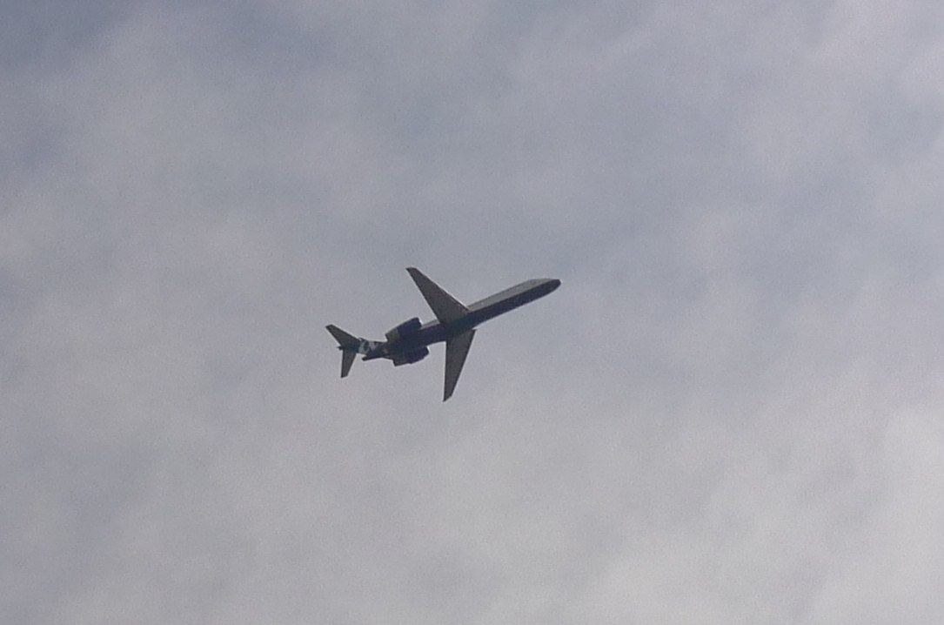
Delta Airlines

Slide 8
Delta Airlines
is a United States airline based and headquartered in Atlanta, Georgia. It is the world's largest airline in terms of passenger traffic and fleet size. Delta, spans from North America, South America, Europe, Asia, Africa, the Middle East, the Caribbean, and Australia. Delta began service to Sydney, Australia from Los Angeles in July 2009, which at the time made it the only current American carrier to serve every continent except Antarctica. Delta flies to over 375 destinations in 88 countries across 6 continents.

Slide 9
Delta Airlines
http://en.wikipedia.org/wiki/Delta_Air_Lines
Delta Stats and Facts:
http://www.delta.com/about_delta/corporate_information/delta_stats_facts/index.jsp
\

Slide 10
Georgia-Pacific

Slide 11
Georgia-Pacific
http://www.gp.com/aboutus/history/index.html
Founded in 1927 as a wholesaler of hardwood lumber, Georgia-Pacific has grown through expansion to become one of the world's leading manufacturers and marketers of tissue, pulp, paper, packaging, building products and related chemicals.
Headquartered in Atlanta, Georgia-Pacific employs more than 45,000 people at approximately 300 locations worldwide.

Slide 12
Home Depot

Slide 13
Home Depot
http://corporate.homedepot.com/wps/portal/History
The Home Depot was founded in 1978 by Bernie Marcus and Arthur Blank. Along with investment banker Ken Langone and merchandising guru Pat Farrah, the founders’ vision of one-stop shopping for the do-it-yourselfer came to fruition when they opened the first two Home Depot stores on June 22, 1979, in Atlanta, Georgia.

Slide 14
Home Depot
Did you know:
http://corporate.homedepot.com/wps/portal/!ut/p/c1/04_SB8K8xLLM9MSSzPy8xBz9CP0os3gDdwNHH0sfE3M3AzMPJ8MAN0sDKADKR2LKmxrD5fHr9vPIz03VL8iNKAcAQCkbGA!!/dl2/d1/L2dJQSEvUUt3QS9ZQnB3LzZfMEcwQUw5MTU1RjBVSEExR0xUMzAwMDAwMDA!/

